Slide 1

Problem Statement and Team Detail
Problem Statement :
Team Name : L0XIQ
Team Leader Name : Kapish Chauhan
Institute Name : GGSIPU EDC(USAR) , BPIT , BVIT
Theme Name :
Team Leader E-Mail ID : kushchauhan765@gmail.com

Slide 2
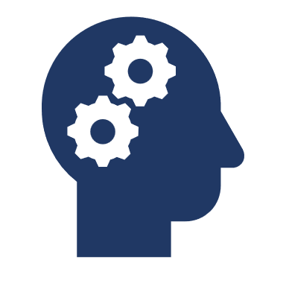
Problem and Solution
Problem: In a space station environment, critical objects like toolboxes, oxygen tanks, and fire extinguishers can be difficult for crew members or autonomous systems to locate quickly. Challenges include varied lighting, objects being partially hidden (occlusion), and the zero-gravity environment. The inability to quickly locate these items poses a significant risk to operational safety and efficiency during both routine tasks and emergencies .
Solution: We have developed an object detection model that accurately and precisely identifies and classifies these three critical objects in real-time. By training our model on a high-quality synthetic dataset from Duality AI's Falcon digital twin, we can simulate the complex conditions of a space station. This allows the model to perform reliably even in challenging scenarios, ensuring that both human and robotic systems can quickly and accurately find essential equipment.

Slide 3
Methodology & Implementation
Our approach was built around a pretty simple, but powerful idea: use the best tools to solve a tough problem. We went with YOLOv8, a great object detection model that's fast and accurate, which is exactly what you need in a high-stakes environment like a space station . The real challenge was getting the right data. We couldn't just take pictures of objects floating around the ISS. That's where Duality AI's Falcon platform came in. We used it to generate a massive, high-quality synthetic dataset. This wasn't just a few pictures; we created a "digital twin" of the space station, simulating everything from weird lighting to objects getting blocked by others (occlusion). This synthetic data let us train the model to be robust and reliable under any condition . Our process looked like this: we took the data from Falcon, labeled all the toolboxes, oxygen tanks, and fire extinguishers. Then we fed that into YOLOv8 and trained it. We spent a lot of time fine-tuning the model, making sure it was as accurate as possible. We measured its performance with mAP scores and used a confusion matrix to see where it was making mistakes, then went back and optimized it. It was a cycle of training, testing, and improving until we had a model we could trust.

Slide 4
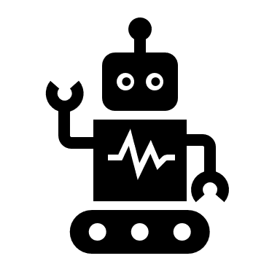
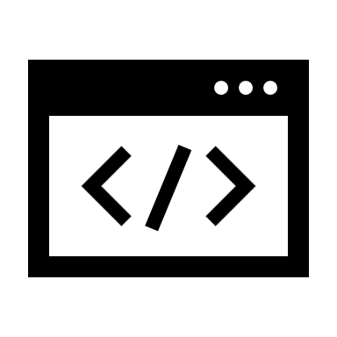
Technology Used
This project was a bit of a showcase for modern AI development tools. At the heart of it all was Duality AI's Falcon platform, which was our data goldmine. It's what let us create a realistic space station environment and get all the training data we needed without ever leaving the ground . For the core of our solution, we relied on YOLOv8, a fantastic object detection model. We chose it because it's known for being a workhorse—it's fast enough for real-time use but still incredibly accurate, which is a key requirement for space applications. We handled all the training and fine-tuning using standard Python AI/ML libraries—the kind of tools that are the backbone of any data science project . And for the bonus challenge, we've got a plan to show how this all comes together in the real world. We'd use something like Flutter to build a simple app. This app would not only use the model to detect objects but would also connect back to the Falcon platform, showing how the model could be continuously updated with new synthetic data to stay current with any changes on the space station.

Slide 5
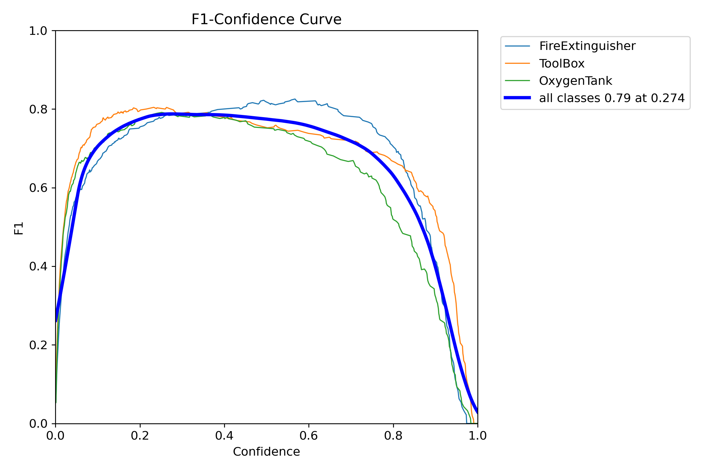
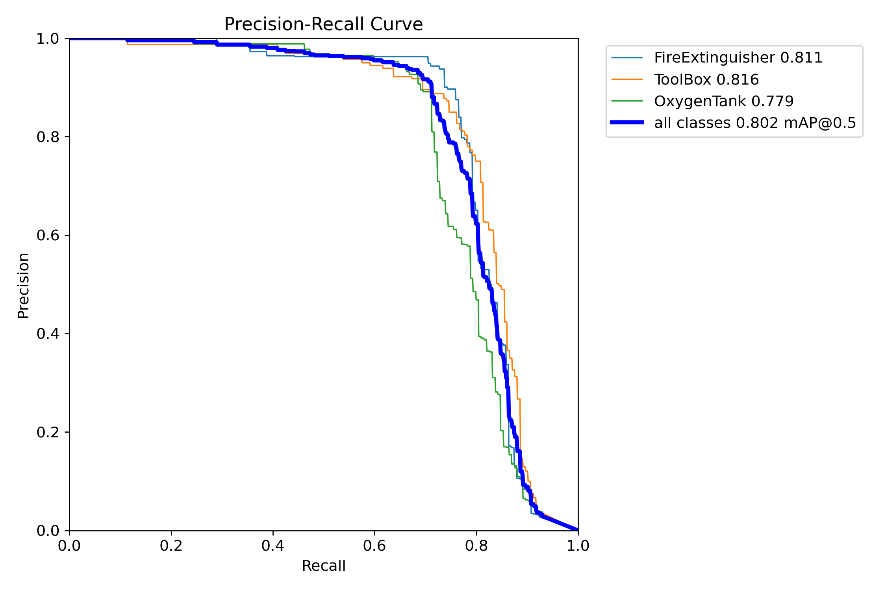
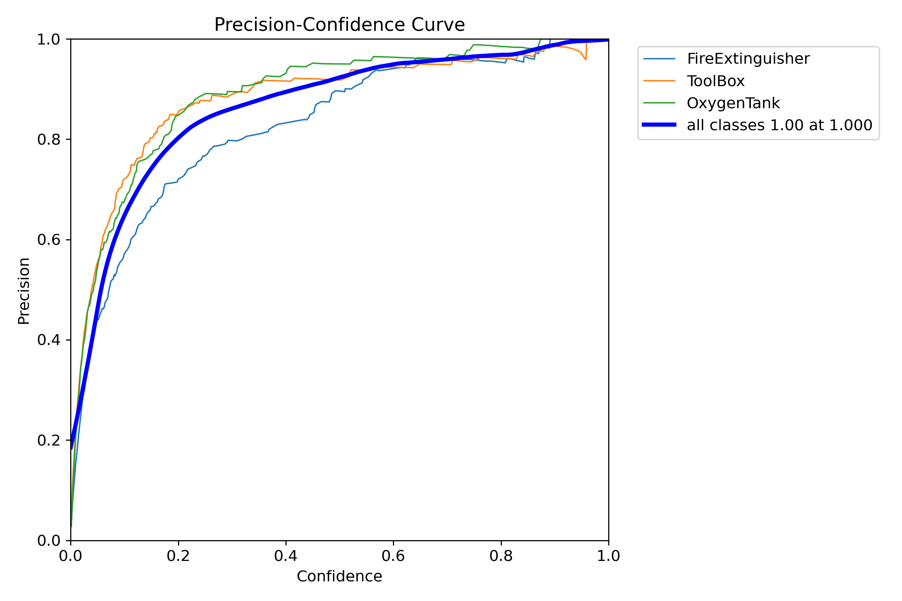
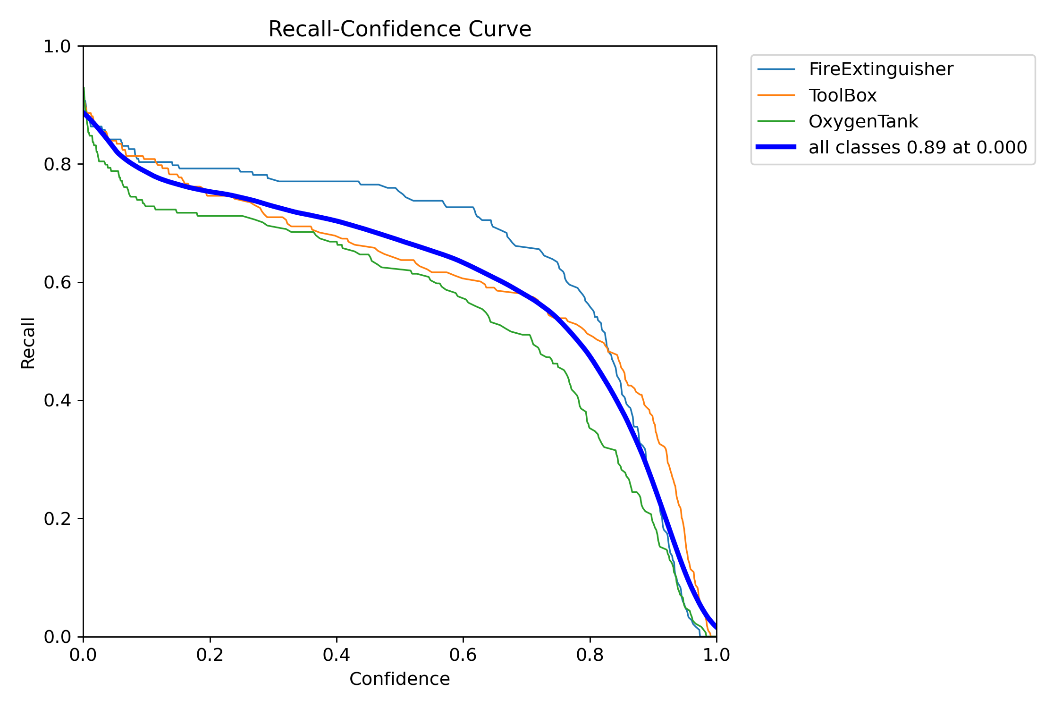
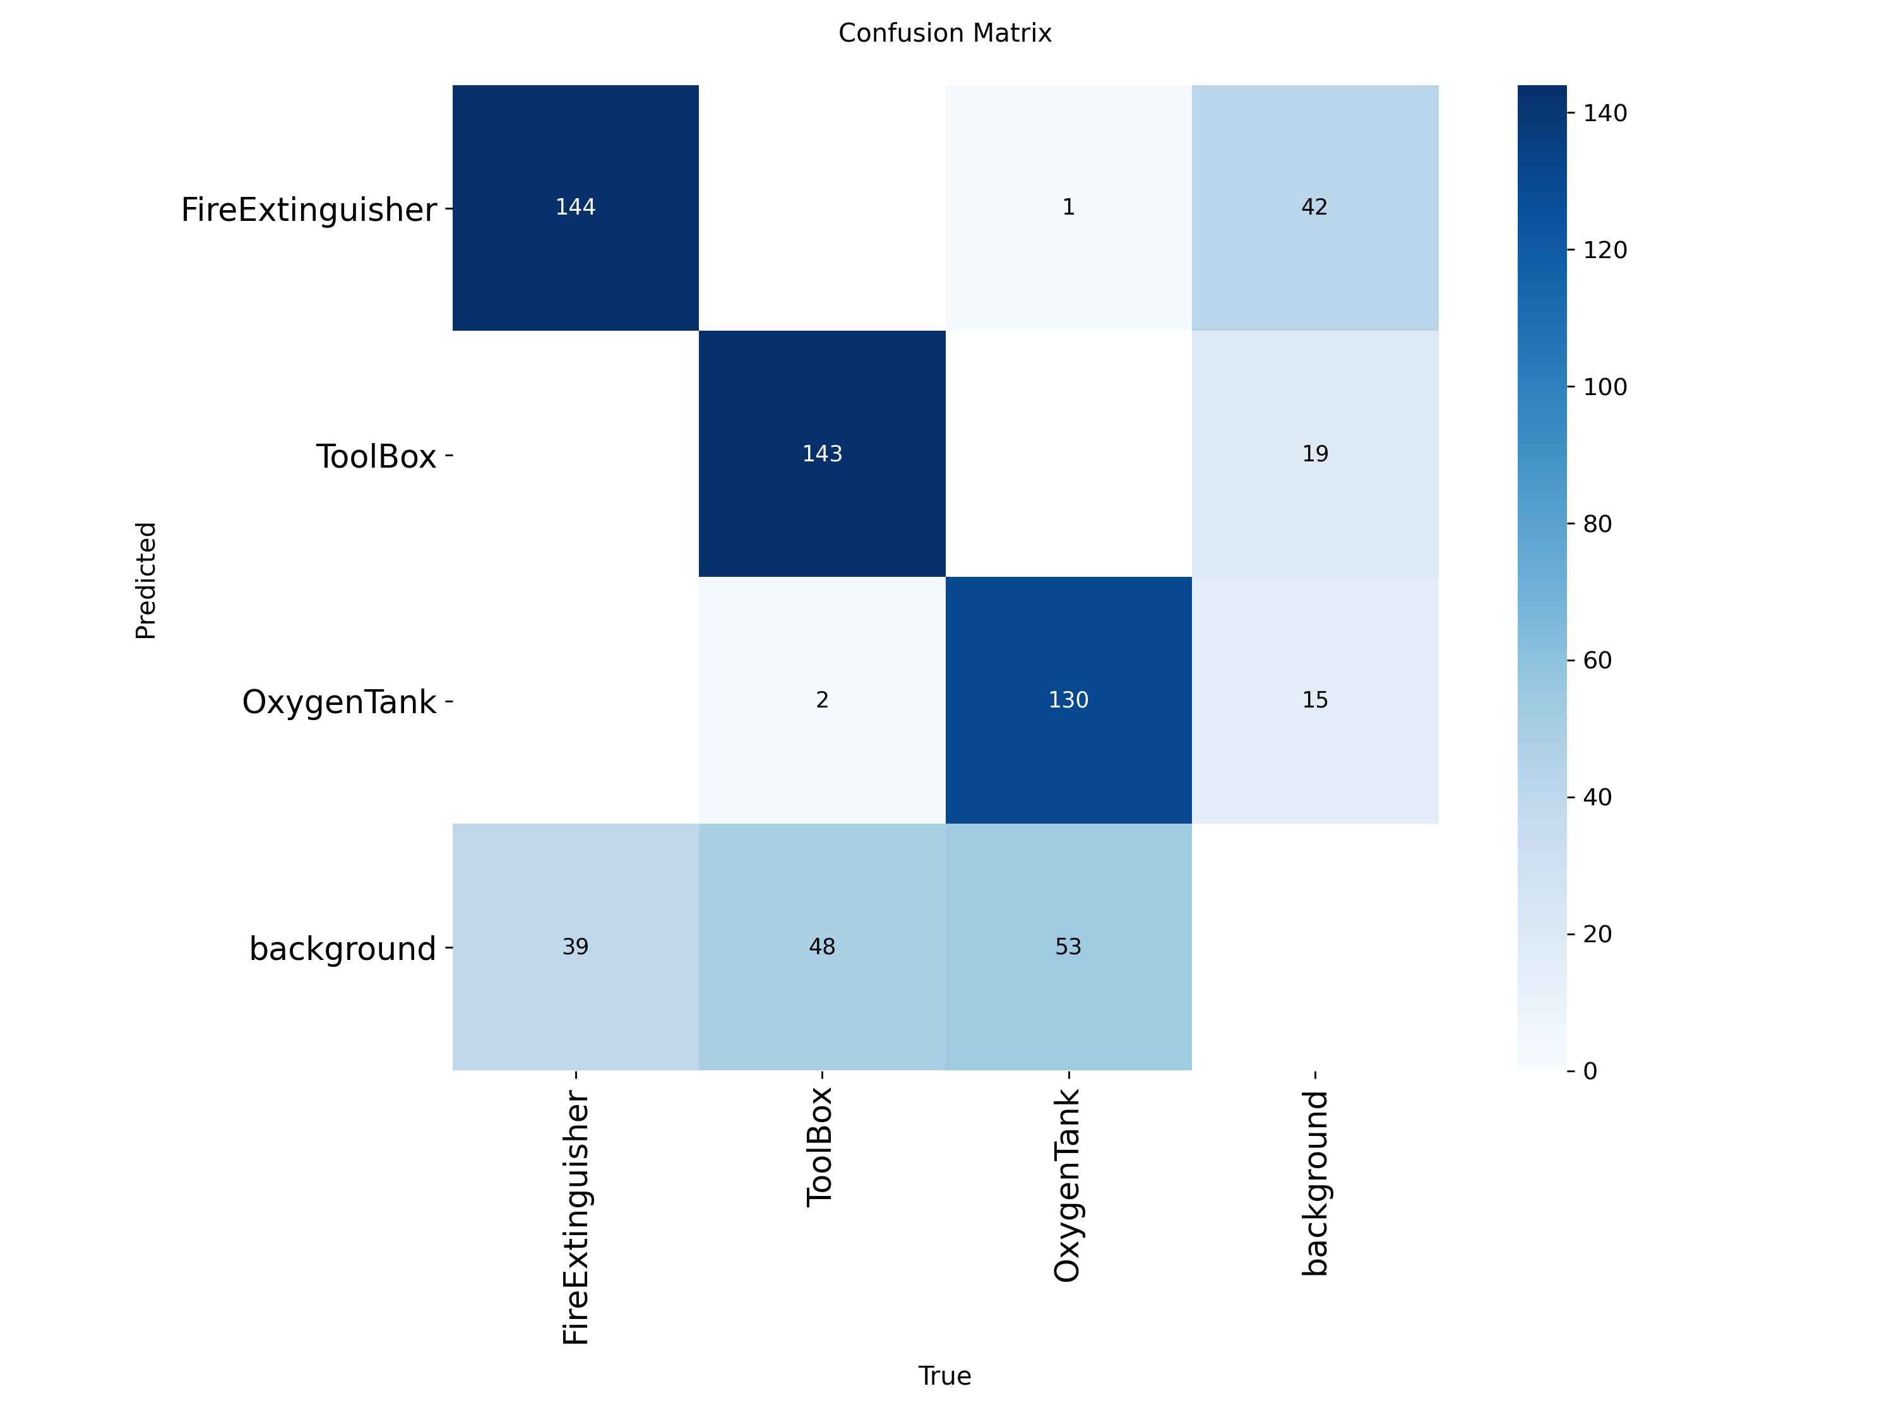
Flow Charts and Supporting Images
Confusion Matrix

Slide 6
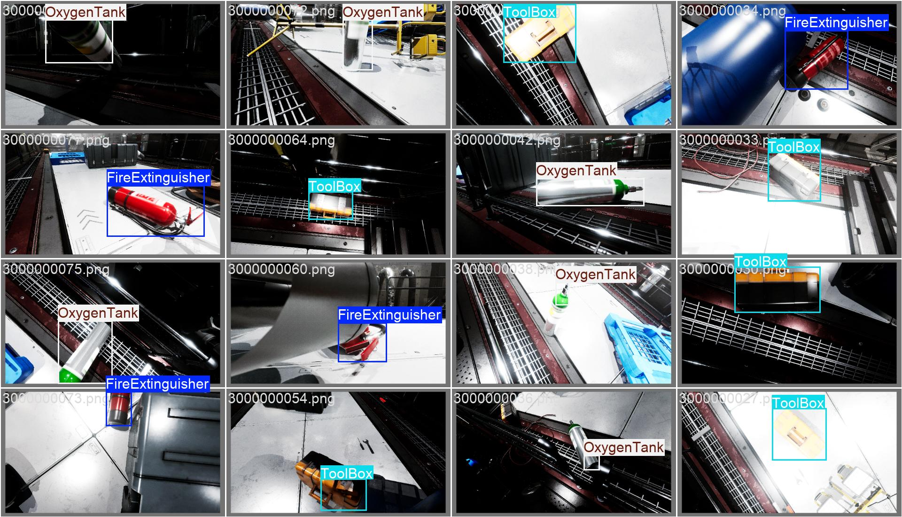
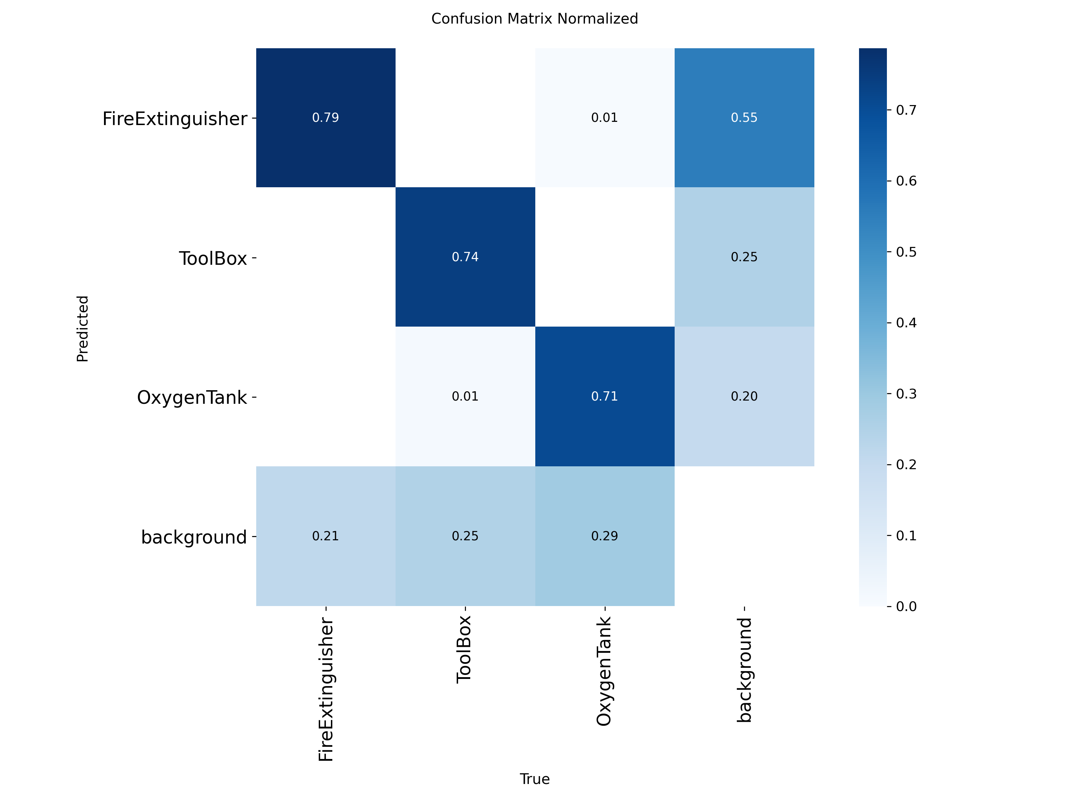
Flow Charts and Supporting Images
Confusion Matrix

Slide 7
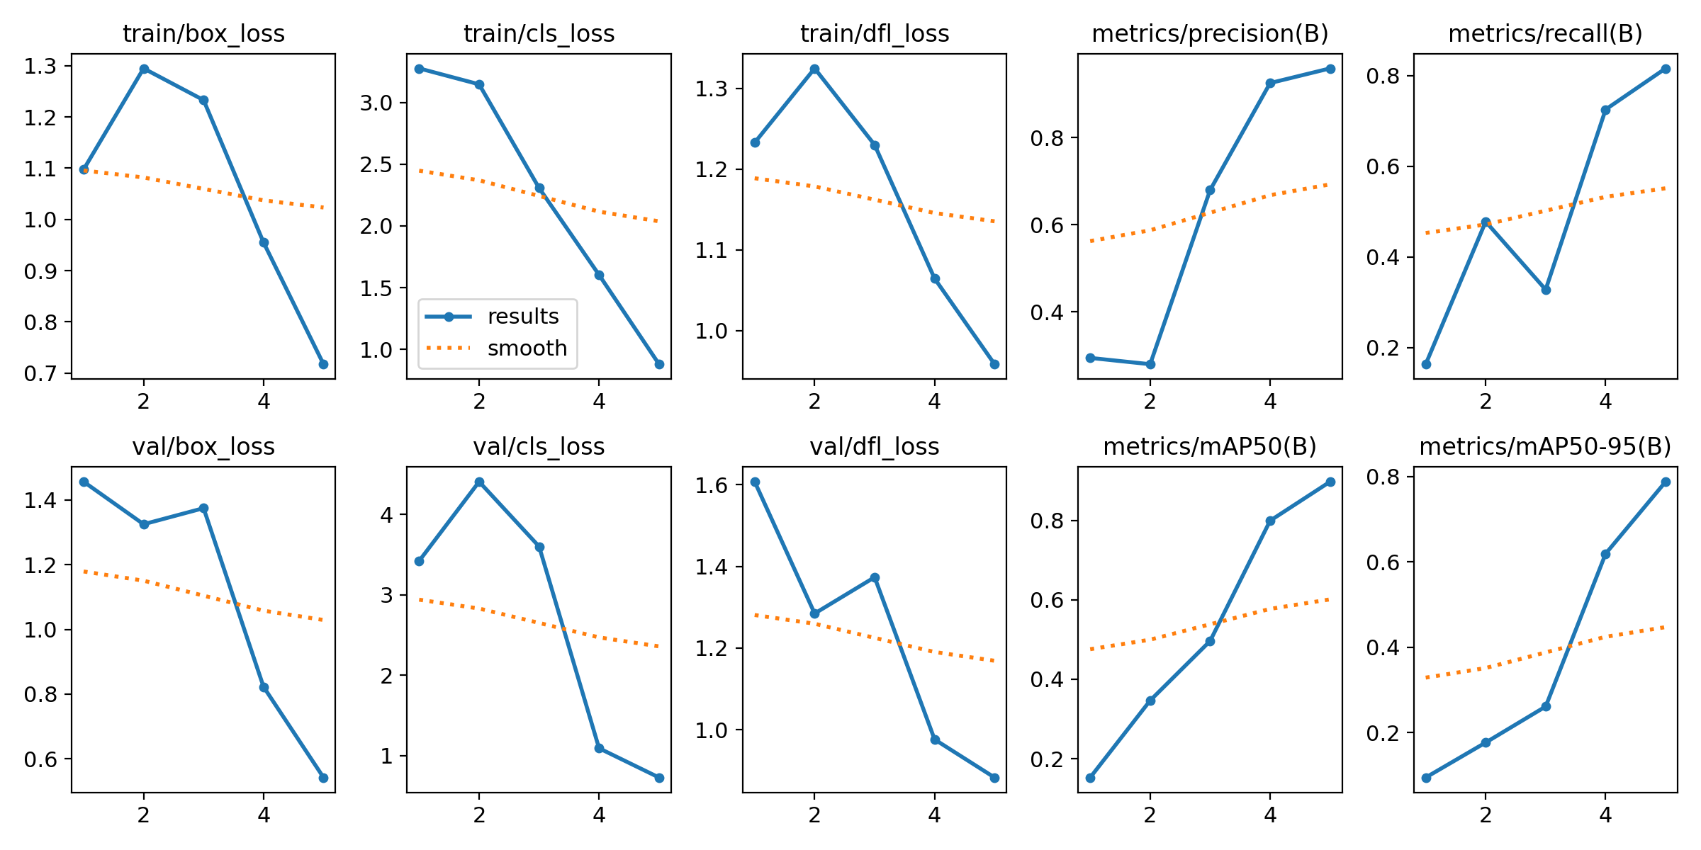
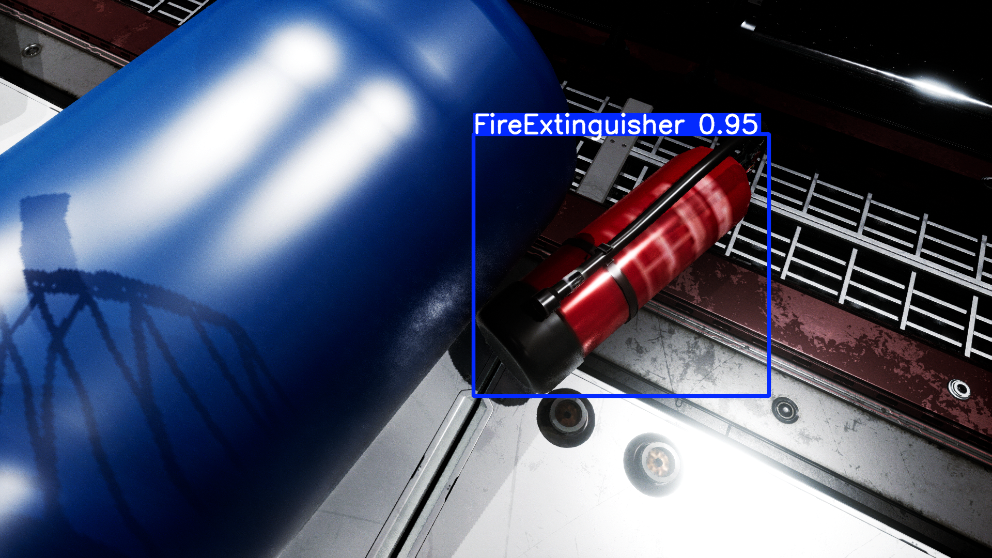
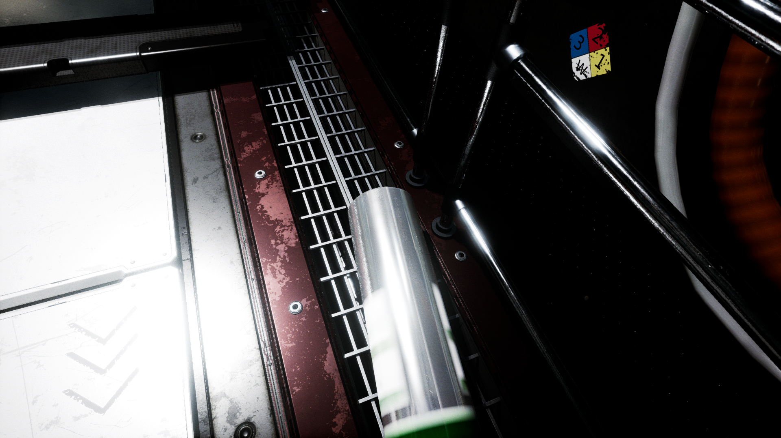
Flow Charts and Supporting Images
Result
Perfect Detection
No Detection

Slide 8
Feasibility and Market Use
Our Differentiator: Our project proves a core concept: building robust, reliable AI for high-stakes environments using only
synthetic data from Duality AI's Falcon. This is scalable, low-cost, and removes the risk of real-world data collection.
Market & Roadmap: We're targeting the booming space economy by providing a critical safety solution.
Initial Applications:
Operational Safety: Real-time object detection for autonomous inventory and emergency equipment location
(e.g., oxygen tanks).
Astronaut Training: Integrate our model into AR/VR simulations for risk-free practice.
Space Robotics: Enable drones and robotic arms to autonomously identify and handle tools.
Future Features: Predictive maintenance (detecting wear and tear) and a user interface for fleet monitoring.
Beyond Space: This methodology is a blueprint for AI in other dangerous environments, from deep-sea exploration to
industrial plants.
Practical Revenue Model: -
We'll start small and grow into a sustainable business.
Pilot Program: Offer a one-time license and support package to a key partner for $50,000 - $150,000.
Subscription:
Convert pilot clients to an annual fee for continuous model updates using Falcon's digital twin, ensuring a
long-term, scalable income stream.

Slide 9
Conclusion
Our project successfully demonstrated that a robust object detection model can be trained for a high-stakes environment like
a space station using exclusively synthetic data. This not only addresses the critical need for operational safety but also provides
a scalable, low-cost, and risk-free alternative to traditional data collection.
Key Innovation :
Our work highlights the power of Duality AI's Falcon platform and digital twin technology. By creating a simulated, data-rich
environment, we proved that AI models can be trained and optimized for high accuracy and efficiency. This methodology serves
as a blueprint for developing AI solutions for other dangerous or inaccessible environments, from deep-sea exploration to
Industrial inspection.
Future Outlook :
This model is a strong foundation for future development. Potential enhancements include expanding the model's capabilities
for predictive maintenance (e.g., detecting signs of wear and tear on equipment) and integrating it directly with autonomous
robotic systems for tasks like inventory management and automated inspections. The use of synthetic data ensures the model
can be continuously updated to adapt to new equipment or scenarios, creating a long-term, maintainable solution.

